Slide 1
Adventure Works
Manufacturing Analysis

Slide 2
Project Group Members
MISS. KEERTHANA KUNDAPUR
MISS. ANJALI RAJENDRA JADHAV
VAISHNAVI SURESH GANGTHADE
RAHUL REDDY KANAMATA REDDY
MR. MRUNAL BHAGWAN THER
DHARNA KEDIA
PROJECT MENTOR: ARIF

Slide 3




TOOLS USED:
EXCEL
MYSQL
TABLEAU
POWER BI

Slide 4
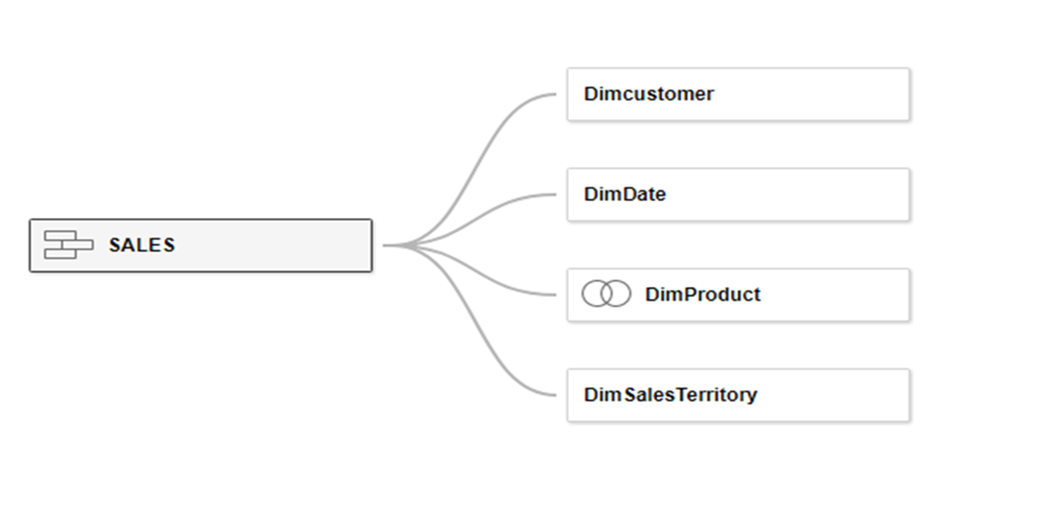
DATA MODEL
Requirement : Fact Internet Sales is Union of 2 tables Fact_Internet_Sales and Fact_Internet_Sales_New.
Dim Product is left Join Dim Product < DimProductSubCategory <DimProductCategoory.

Slide 5
KPI’S
Create the Combinational Chart.
Create Line Chart as below using English Month Name , Year and Sales Amount.
Create Donut Chart.
Create a crosstab , Ensure the Formatting , Border and Color Scheme.
Create the Below Bar chart with the option for user to Switch between the SALES, COST, PROFIT using parameter, Title of the Chart also should Change Accordingly.
Create a TOP N chart as below using Parameter.
Create Advanced Funnel Chart as below for Country vs SalesAmount
Create a Pareto Chart as Below Using English Product Name and Sales Amount.
Create Bump Chart using English Monthname , Salesterritory Country and Sales Rank.
Create a KPI worksheet .

Slide 6
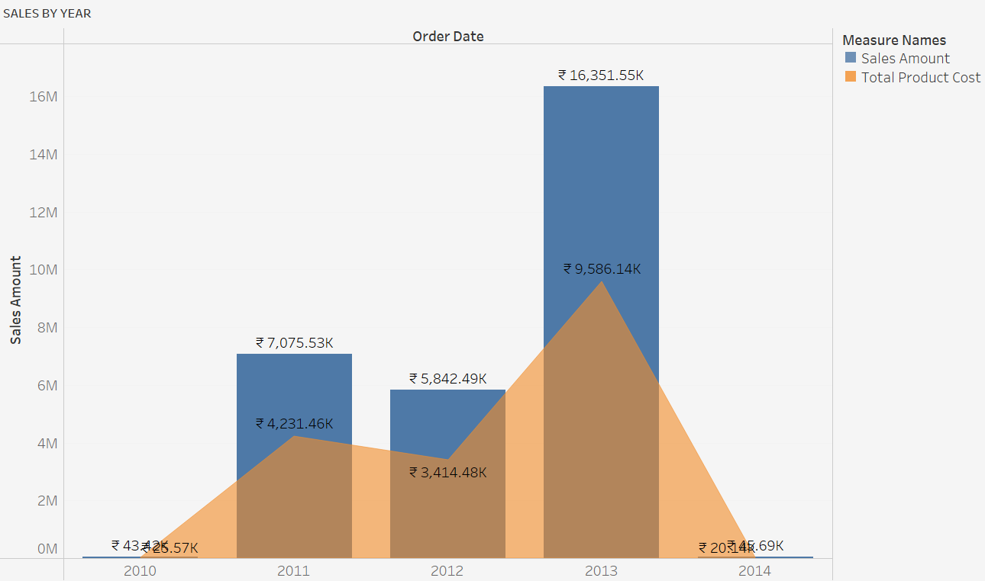
KPI 1
It is a Combinational Chart in which bar represents the Sales Amount and Area represents the Total Product Cost.
Here we can conclude that Year 2013 has highest Sales and Cost amount.

Slide 7
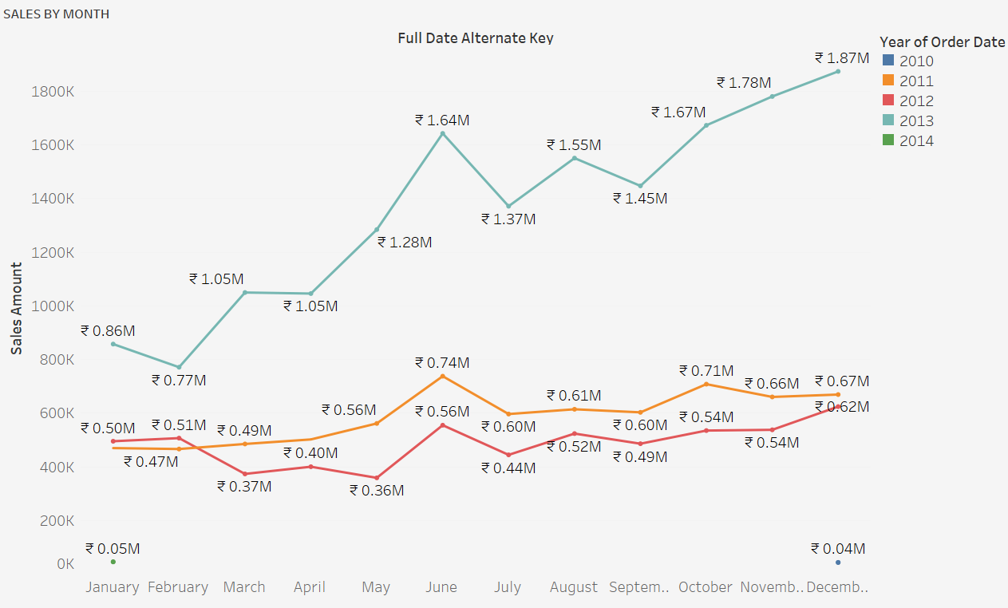
KPI 2
Here we can conclude that year 2013 the month December has the highest Sales Amount.

Slide 8
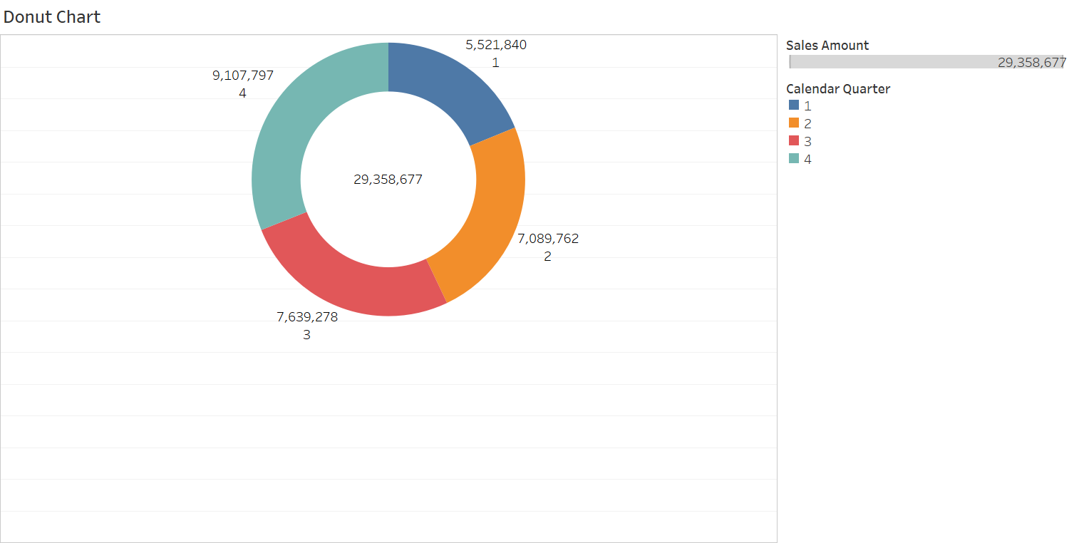
KPI 3
Here Compare to all 4 Quarter, Qtr-4 has the highest Sales Amount.

Slide 9
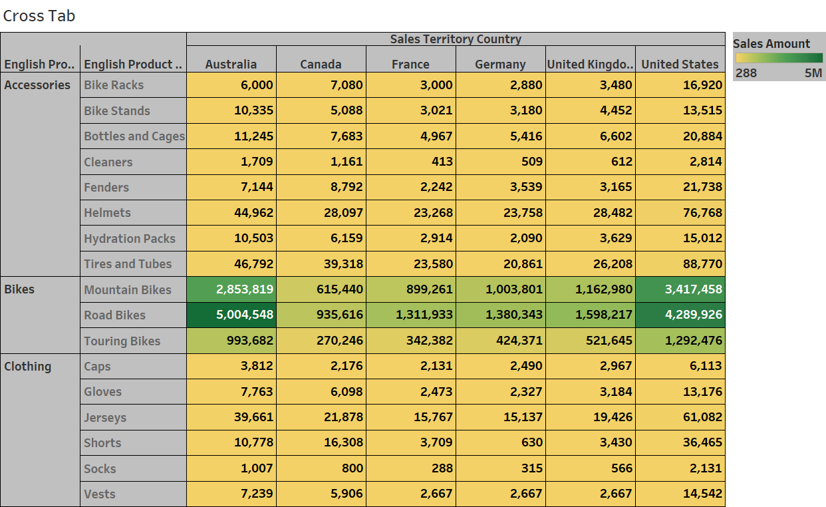
KPI 4
Here in the above Chart, the Darker Green colour represent the highest Sales Amount.
So Here we can Say that Australia Country has the highest Sales Amount.

Slide 10
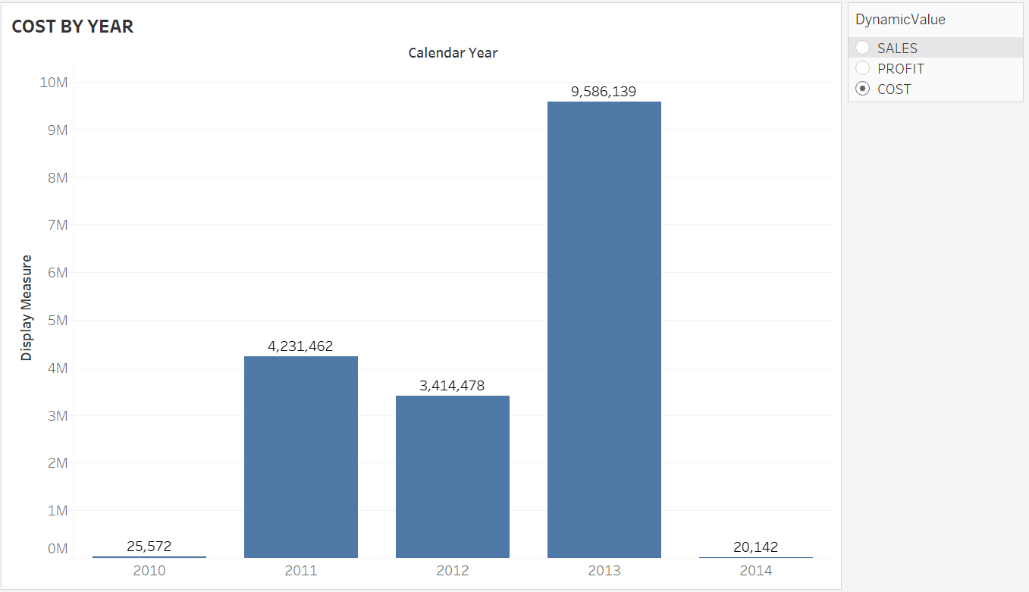
KPI 5
Here in this graph Shows the Year wise Sales, Profit and Cost by using parameter.
So we can conclude that year 2013 has the highest Sales, Cost as well as Profit.

Slide 11
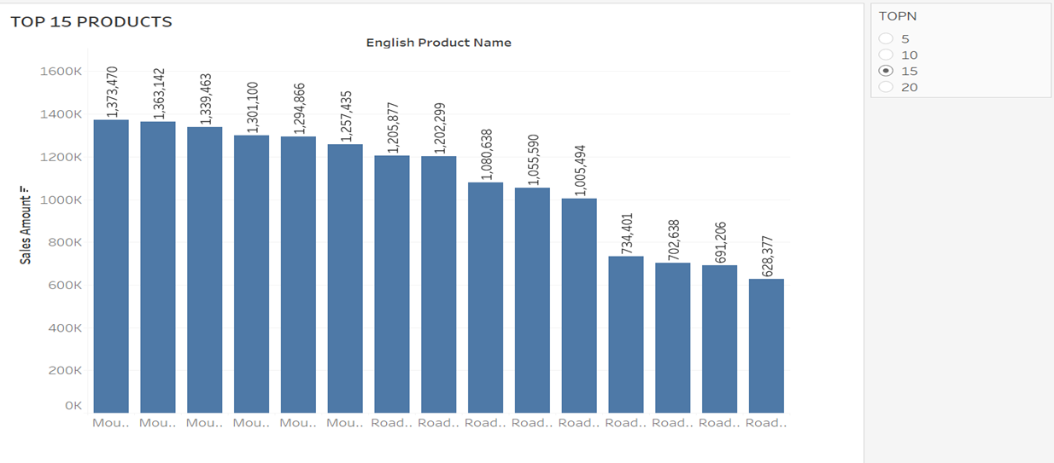
KPI 6
Here by using Parameter we can Check the Sales Amount for Top N product with respect to English Product Name.
Here we can Conclude that English product Name mountain-200 Black,46 holds the highest Sales Amount.

Slide 12
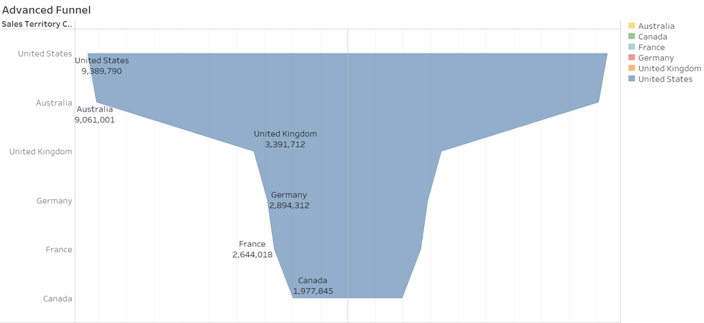
KPI 7
Here the Sales Territory Country United State has the highest Sales Amount And Canada has the Lowest.

Slide 13
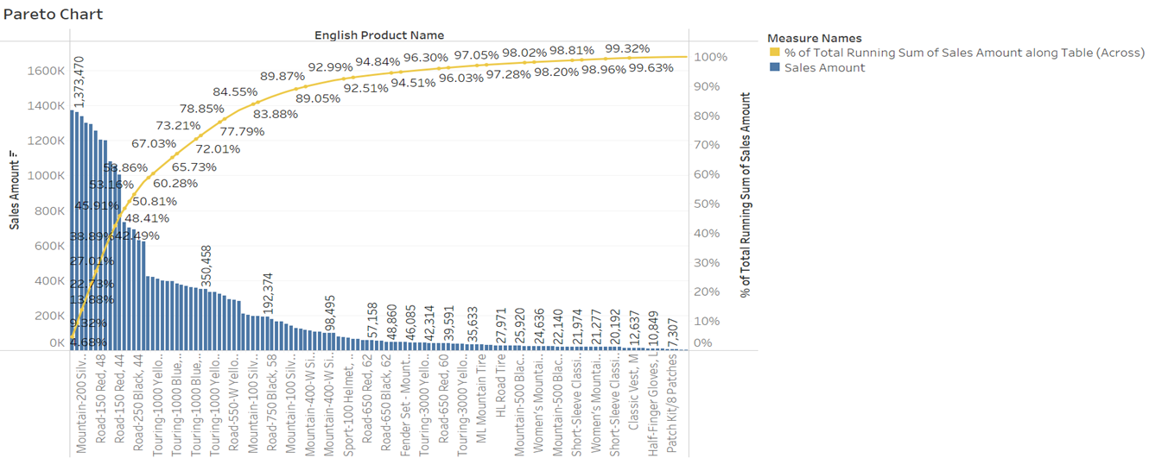
KPI 8
In the Above Chart Bar represent the Sales Amount and line represent the % of Total Running Sum of Sales Amount.
Here English Product Name Mountain-200 Black, 46 holds the highest Sales Amount.

Slide 14
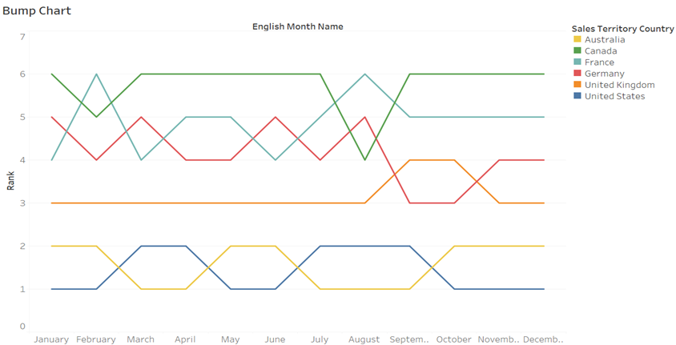
KPI 9
In Bump Chart with the help of Rank Calculation we concluded that on the month of January United State has the highest Rank and Canada has the lowest rank in terms of Sales Amount. So we can Check the Rank of States in each month.

Slide 15
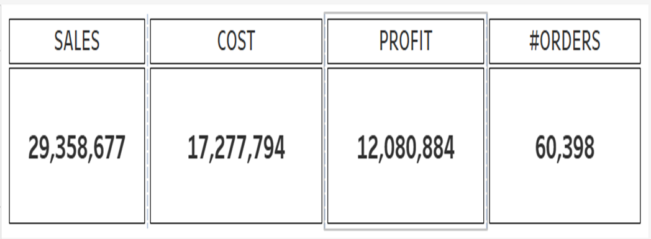
KPI 10
So with the help of cards we showed the total Sales Amount, Cost, Profit and number of orders.

Slide 16
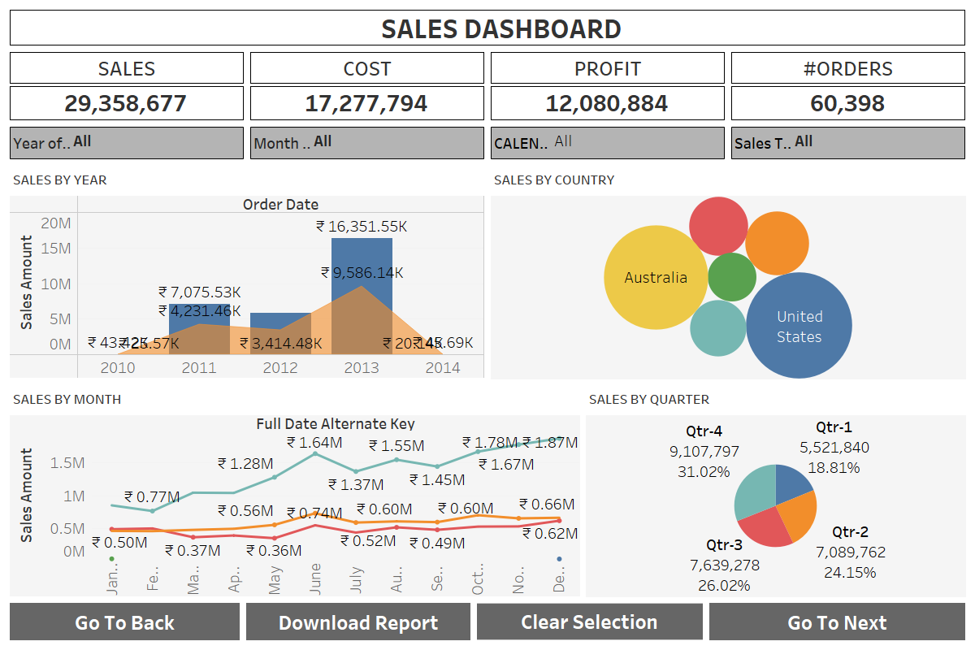
Dashboard

Slide 17
Conclusion
From this Dashboard we can conclude that Year 2013 has highest Sales amount and Total Product Cost.
In terms of Sales Territory Country United States Has highest Sales Amount and Canada Has the lowest.
In the Year 2013 the month December has the highest Sales Amount.
In terms of Quarter, Qtr-4 has the highest Sales Amount.

Slide 18
Thank You!!

